Slide 1
Convert Text into Characters or Words Macro
This macro is used to create text based animation or special effects
Next few slides illustrate how this can be done
Select a textbox or a shape containing text
Go to View tab – Macros and run:
  Text2Chars: Creates multiple textboxes containing individual characters
  Text2Words: Creates multiple textboxes containing individual characters
  Original shape or text is not affected
All items are created at top left corner and are overlapped initially
Select all of them, go to Arrange - Align, choose Align to Slide and again choose Arrange – Align – Distribute Horizontally.

Slide 2
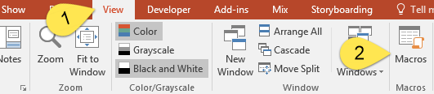
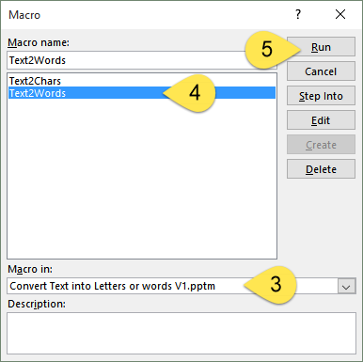
Quick Reference

Slide 3
This is how it works
T
h
i
s
i
s
h
o
w
i
t
w
o
r
k
s
Text2Chars
The text above is the base text.
Each character is converted to a new shape. The newly created shapes are arranged at the top of the slide. Original formatting is retained.
Open the Selection Pane (Home – Select dropdown) to view and manipulate individual objects. Each object has the same name as its contents.

Slide 4
This is a demo
This
is
a
demo
Text2Words
The text above is the base text.
Each word is converted to a separate shape and distributed across the slide at the top. Original formatting is retained.
The name for each shape is the same as the text contained in it. These names can be seen in the Selection Pane (Home – Select – Selection Pane).

Slide 5
Practical Usage
Once you have individual characters or words, you can play with them
Here are a few examples
Use this to create appealing Text Art (Typographical Art)

Slide 6
O
A
V
A
R
I
T
I
N

Slide 7
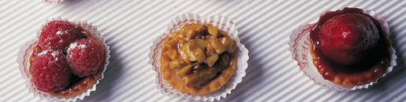
Are
you
for
Knowledge?

Slide 8
1
Save
hour
every
every
every
every
every
every
every
day

